Slide 1



Final IPR
C/2d Lt Al Luhaibat and C/Capt Osborne Mahiques
Air Force ROTC Detachment 842
The University of Texas at San Antonio

Slide 2


Overview
Objective
Chain of Events
In-processing
Groupings/Campus Tour
Volunteers/Roles
Equipment
Contingency
Questions
Air Force ROTC Detachment 842 • We Build Exceptional Officers • The University of Texas at San Antonio

Slide 3
Objective
Primary Goal: Provide a seamless and professional onboarding experience for new cadets during NSOP.
Key Outcomes:
Efficient in-processing of all new cadets.
Clear communication and guidance throughout the event.
Set the standard for professionalism and expectations in AFROTC.
Air Force ROTC Detachment 842 • We Build Exceptional Officers • The University of Texas at San Antonio

Slide 4
Chain of Events
Time | Activity | Location | Personnel
0700 | Volunteer Arrival & Setup | Detachment | All Volunteers
0800-0900 | New Cadet Arrival Begins & In-Processing | Detachment Entrance | All Volunteers
0900-0930 | Quick Intro/SLACK Setup | Joint Classroom | C/Al Luhaibat, C/Osborne Mahiques
0930-1100 | NCO Time | Joint Classroom(for now) | NCOs
1100–1230 | Briefings & Introductions | Joint Classroom | Briefers
1230–1315 | Lunch | Beside NPB | Booster Club
1315-1600 | Campus Tour/Icebreakers/Q&A | Campus | Volunteers
Air Force ROTC Detachment 842 • We Build Exceptional Officers • The University of Texas at San Antonio

Slide 5
In-Processing
Arrival at Detachment
Guidance: C/Fanning directs arriving cadets to the holding area.
Holding Area: Hallway outside the detachment.
Height/Weight Check
Location: Flight Sim Room(Female) & GMC Office(Male)
Personnel: C/Bushong & C/Sanchez
Process: Cadets undergo height and weight measurements.
If Cadets Pass: Proceed to Uniform Measurements.
If Cadets Fail: Provided with guidance and next steps with cadre.
Uniform Measurements
Location: POC Office(Female) & Cadet Lounge(Male)
Personnel: C/Oveson, C/Graschel, C/Davis, W
Process: Cadets get measured for uniforms.
Air Force ROTC Detachment 842 • We Build Exceptional Officers • The University of Texas at San Antonio

Slide 6
In-Processing Cont.
Landing Fee Payment & Uniform Pickup
Location: Detachment Classroom
Landing Fee ($60): Collected by Booster Club.
Uniform Items: Det Polo and Dry Fit shirt distributed by Booster Club.
Document Verification
Location: Detachment Classroom
Personnel: C/Anderson
Process: Check all required forms and confirm physicals.
Special Cases Processing
For CAP/JROTC/Prior Military Cadets
Location: Detachment Classroom
Personnel: C/Nguyen
Process: Handle specific documentation and questions.
Air Force ROTC Detachment 842 • We Build Exceptional Officers • The University of Texas at San Antonio

Slide 7
In-Processing Cont.
Slack Setup & Q&A
Location: Joint Classroom
Personnel: C/Olivares
Process: Assist cadets in setting up Slack; answer any questions. Sort cadets into their “groups” for the day.
Transition to NCO Time
Guidance: Volunteers direct cadets to the Joint Classroom for NCO Time.
Air Force ROTC Detachment 842 • We Build Exceptional Officers • The University of Texas at San Antonio

Slide 8
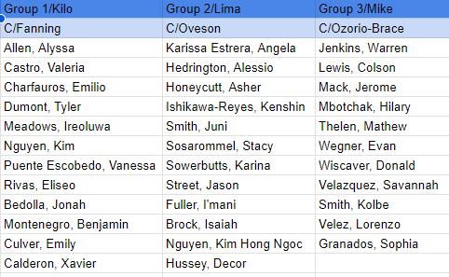
Groupings
Group Leaders: C/Fanning, C/Oveson, C/Ozorio-Brace
Gameplan:
Kilo Group starts at Campus Tour
Lima Group starts at Icebreaker/GLP
Milke Group starts at Q&A
Rotate every 30 min. with 5 min. transition
Air Force ROTC Detachment 842 • We Build Exceptional Officers • The University of Texas at San Antonio

Slide 9
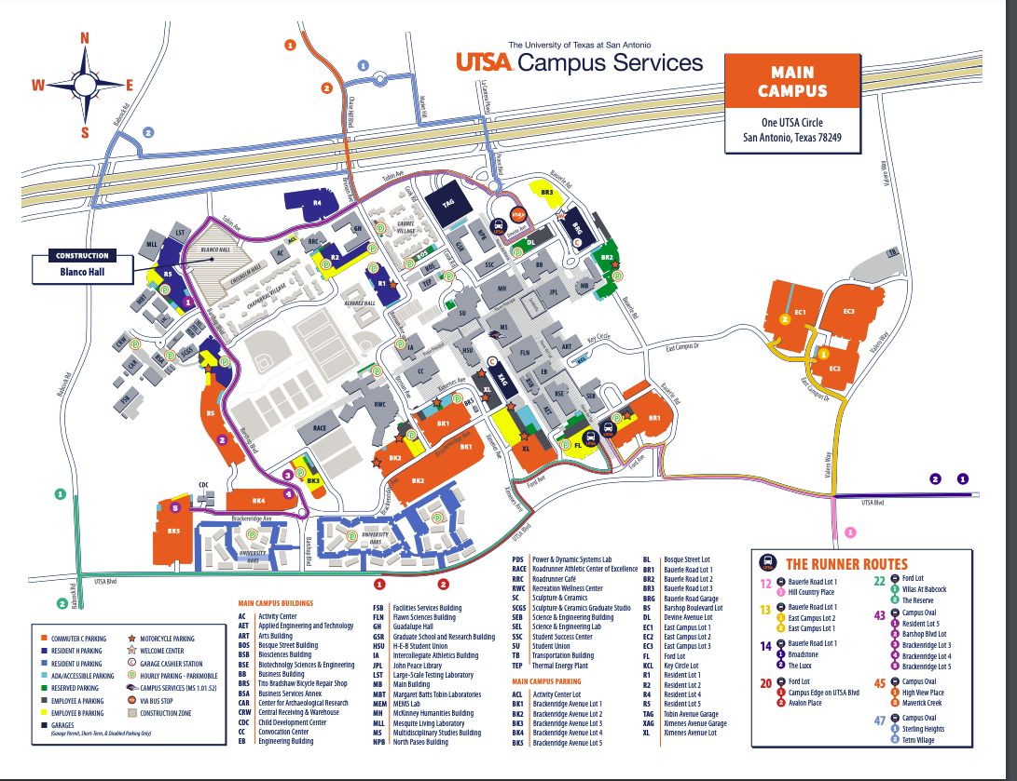
Campus Tour
Tour Guides: C/Anderson & C/Camacho
Gameplan:
Detachment->
Dining Areas/Student Union->
Sombrilla/Library->
Main Building
Air Force ROTC Detachment 842 • We Build Exceptional Officers • The University of Texas at San Antonio

Slide 10
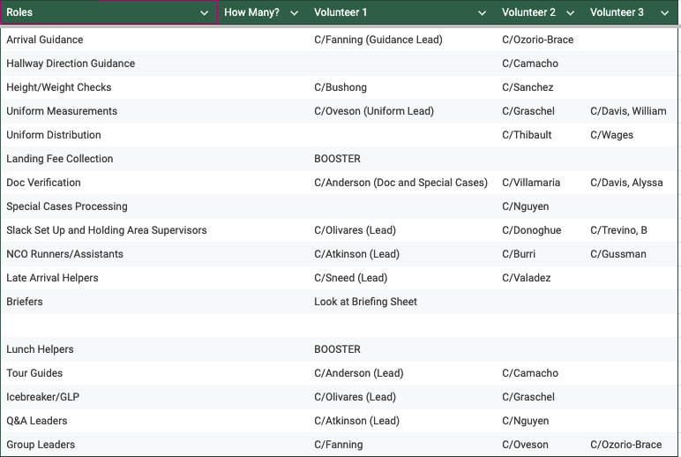
Volunteers/Roles
Air Force ROTC Detachment 842 • We Build Exceptional Officers • The University of Texas at San Antonio

Slide 11
Equipment
In-Processing Stations | Technology | Signage & Materials
Height/Weight scales and measurement tools. | Laptops/Phones for Slack setup. | Directional signs within the building and breezeway.
Organized uniform items by size (Polos, Dry Fit shirts). | Projector and screen for briefings. | Printed schedules and maps.
Extra copies of required forms and checklists. |  | Signs on doors and table so cadets know where to go.
Air Force ROTC Detachment 842 • We Build Exceptional Officers • The University of Texas at San Antonio

Slide 12
Contingency
Late Arrivals:
Procedure: Late arrivals are directed to a dedicated volunteer who guides them through an expedited in-processing.
Missing Documentation:
Solution: Have spare forms available; set up a station for cadets to fill out missing paperwork on-site.
Technical Difficulties:
Backup Plans: Extra devices for Slack setup; IT support available to troubleshoot issues.
Bad Weather:
Eat in Detachment Classroom instead of outside
Instead of campus tour, do a detachment tour.
Air Force ROTC Detachment 842 • We Build Exceptional Officers • The University of Texas at San Antonio

Slide 13
Questions?

Slide 14
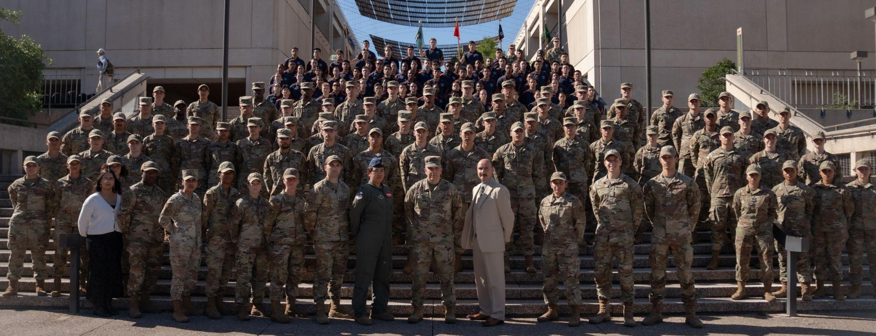
Air Force ROTC Detachment 842
The University of Texas at San Antonio
Det 842 – Best in Blue

